Slide 1
Semantic Music Clustering and Recommendation
Neil Auroni
COMP 590

Slide 2
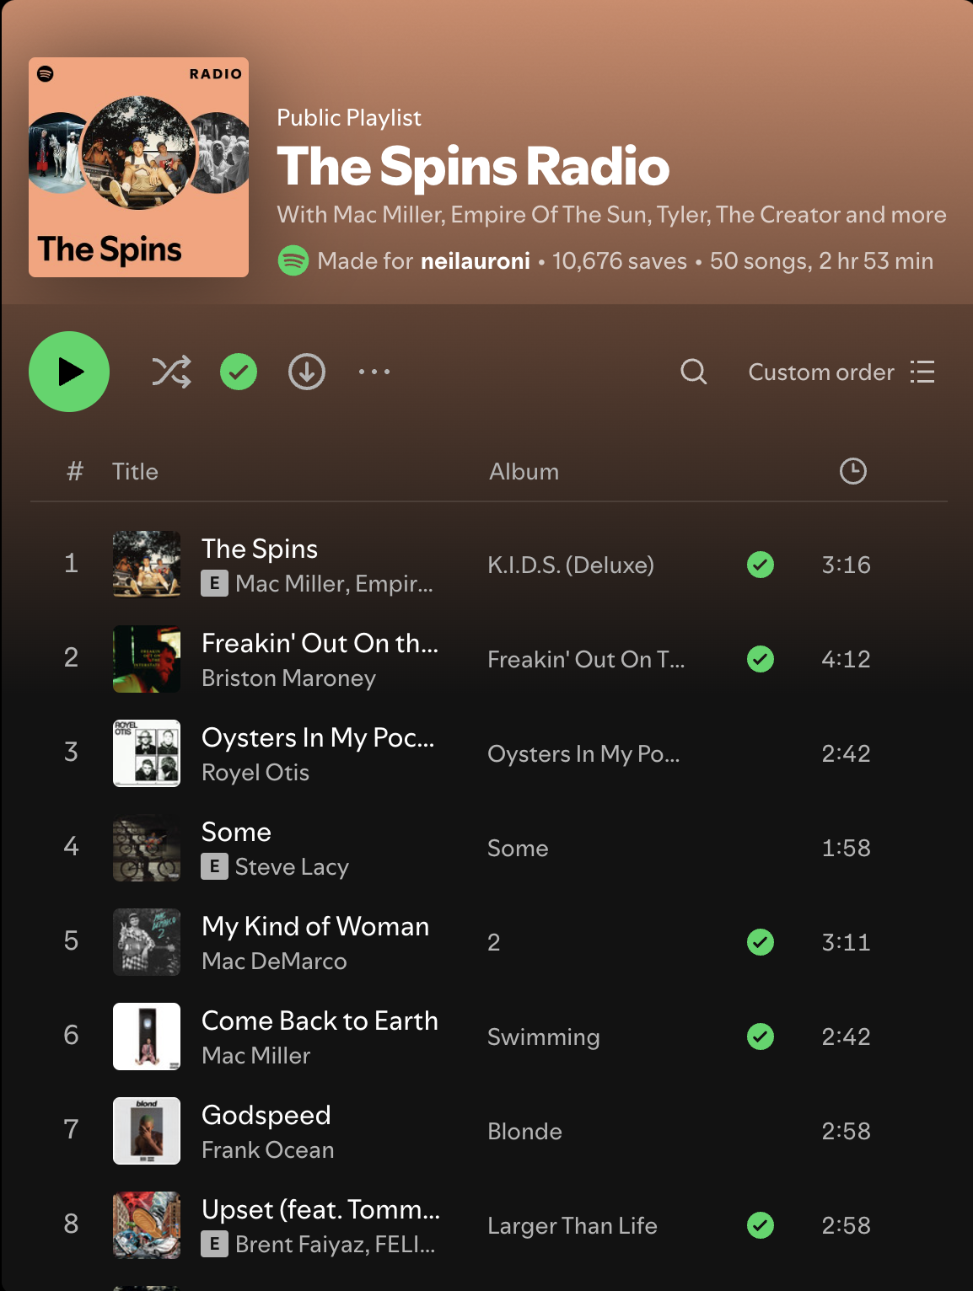
Traditional Recommendations Don’t Work
Song recommendations are not based on the “vibe” or actual content of the song, but rather collaborative filtering based on similar community tastes.
This project expands on my previous work building a customized-embedding space for audio files to recommend songs based on semantic similarities.
I propose a clustering method, along with an extension of the CLIP (Contrastive Language-Image Pre-Training) model to recommend songs based on natural language queries.

Slide 3
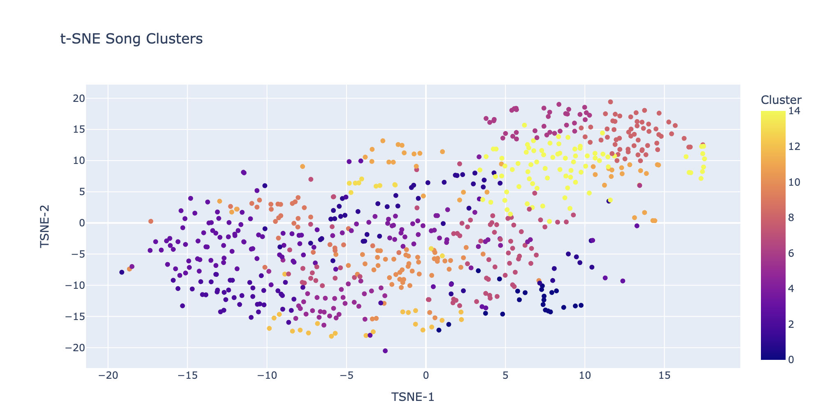
Clustering
Using a t-SNE clustering algorithm on our song embeddings, we can group similar sounding songs together — independent on external metadata like genre, artist, and BPM.

Slide 4
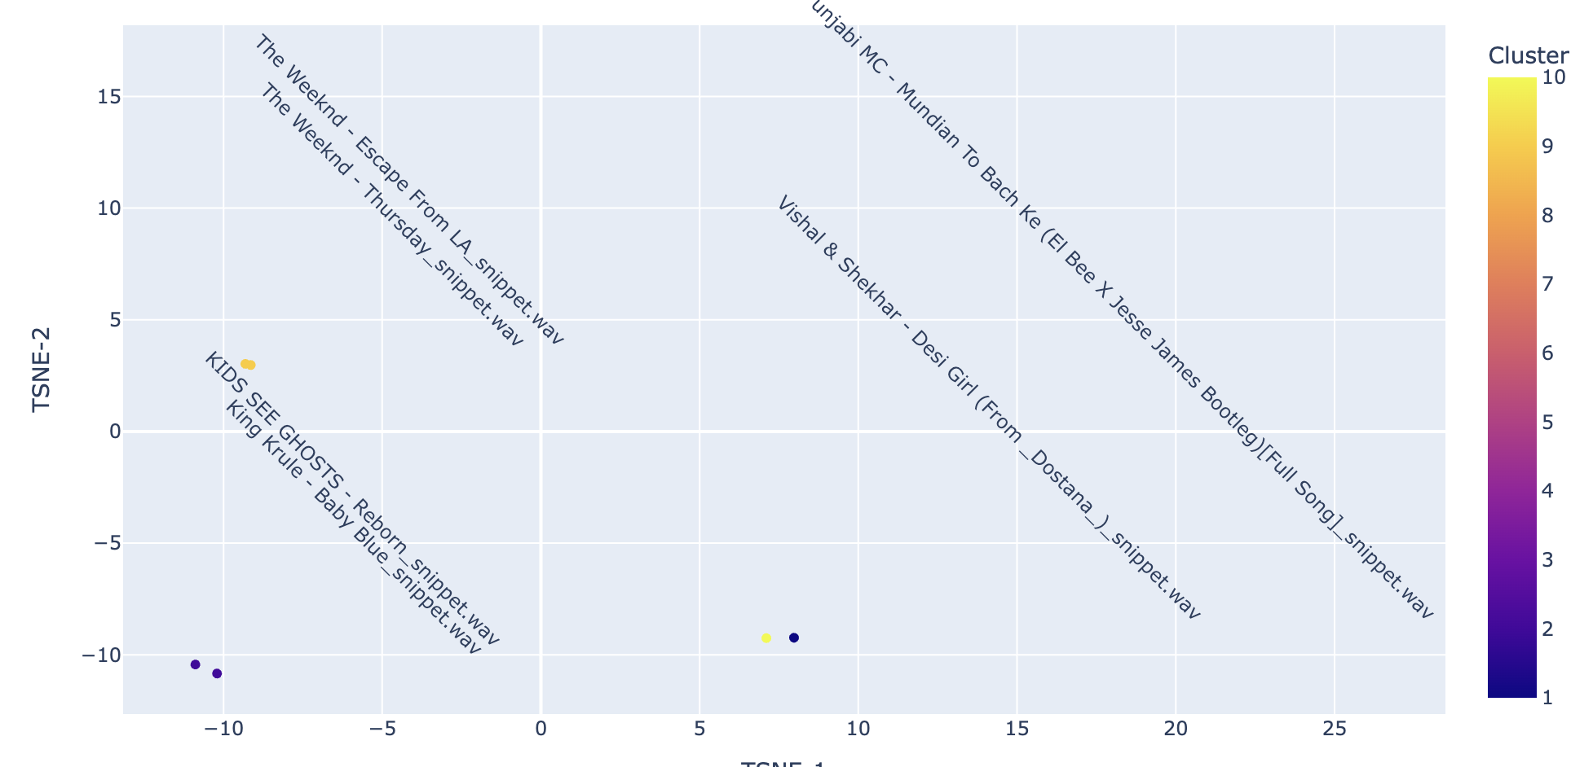
Clustering correctly groups together similar sounding songs — even Indian music is clustered together without any mention song title.

Slide 5
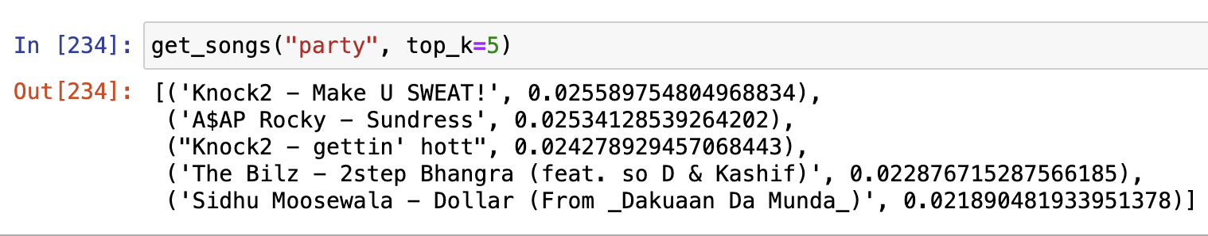
Implementing Text2Audio
Using the Spotify API, we get genre descriptions for songs. We then train a simple feedforward neural network with CLIP loss using training pairs — (song_embedding, genre_descriptions)
To get most similar songs, we run through our model and use cosine similarity to compare the text embedding to the audio embedding and return the top_k most similar tracks.
Text -> 382-dim vector -> Text2Audio -> 128dim audio vector

Slide 6
Questions?

